Slide 1
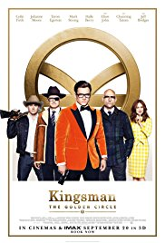
FILM REVIEW WEBSITE
HOME
ABOUT
NEWS
DISCOVER
COMMUNITY
LOGIN OR REGISTER
Movie Info
"Kingsman: The Secret Service" introduced the world to Kingsman - an independent, international intelligence agency operating at the highest level of discretion, whose ultimate goal is to keep the world safe. In "Kingsman: The Golden Circle," our heroes face a new challenge. When their headquarters are destroyed and the world is held hostage, their journey leads them to the discovery of an allied spy organization in the US called Statesman, dating back to the day they were both founded. In a new adventure that tests their agents' strength and wits to the limit, these two elite secret organizations band together to defeat a ruthless common enemy, in order to save the world, something that's becoming a bit of a habit for Eggsy...
Rating: R (for sequences of strong violence, drug content, language throughout and some sexual material)
Genre: Action & Adventure, Comedy
Directed By: Matthew Vaughn
Written By: Jane Goldman, Matthew Vaughn
In Theatres: Sep 20, 2017 limited
On Disc/Streaming: Dec 12, 2017
Box Office: £99,733,121
Studio: 20th Century Fox

